Slide 1
Jenna Birch, MMATH student
Department of Mathematical Sciences

Slide 2
Examples of Networks:
Networks in Travel,
Biological Networks,
Social Networks,
Modelling Financial Situations

Slide 3
The Unsecured UK Loan Market Insight the Network Theory

Slide 4
Example of a Basic Finance Network

Slide 5
Adjacent Matrix
The matrix shows:
l_{ij} = 1 shows a link from node i to node j
l_{ij} = 0 shows no link from node i to node j
1
2
4
3
5
8
6
7
11
9
10
12

Slide 6
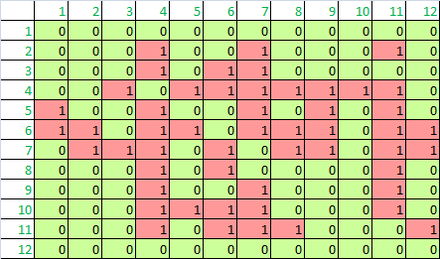

Slide 7
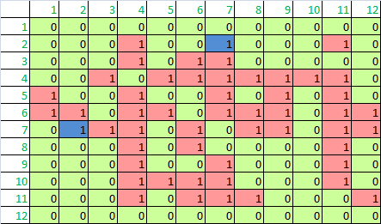

Slide 8
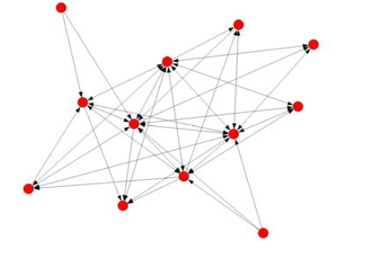
1
2
3
4
5
8
6
7
11
9
10
12

Slide 9
Look at Core and Non-Core
CORE
C= {4, 6, 7, 11}
NON-CORE
N={1, 2, 3, 5, 8, 9, 10}

Slide 10
Borrowed from:
CC = 12
NC = 17
CN = 18
NN = 5
Lent money to:
CC = 12
NC = 18
CN = 19
NN = 3

